Slide 1


Aortic Valve Repair
-
Alternative to Replacement
H.-J. Schäfers
Dept. of Thoracic and Cardiovascular Surgery
University Hospital of Saarland
Homburg/ Saar
Germany
THG
Notes:
1

Slide 2
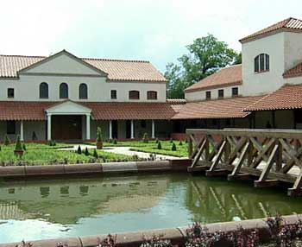
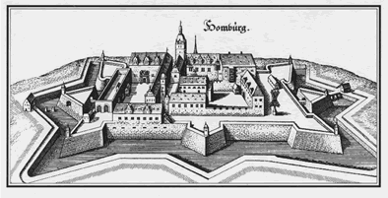
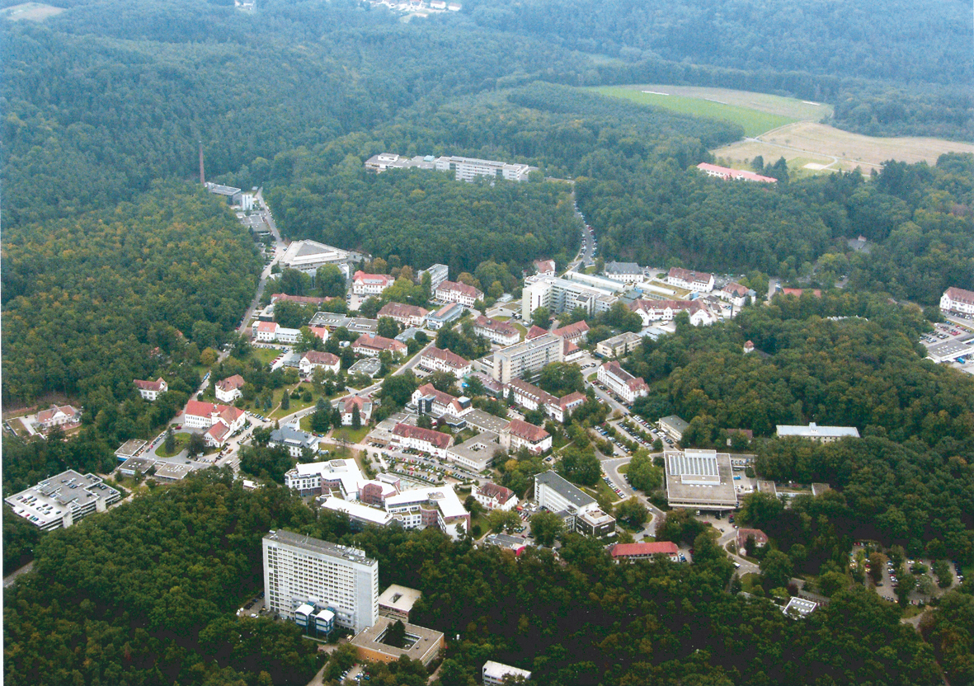
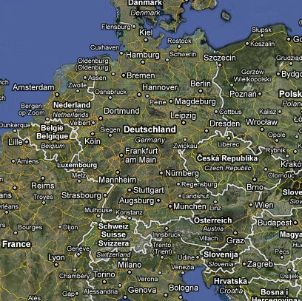




Slide 3
Aortic Valve - Historic Repair Attempts
THG
Notes:
3
.

Slide 4
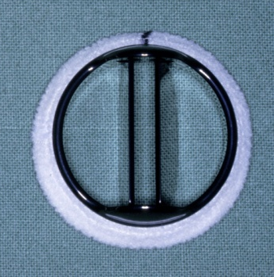
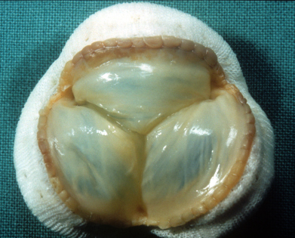
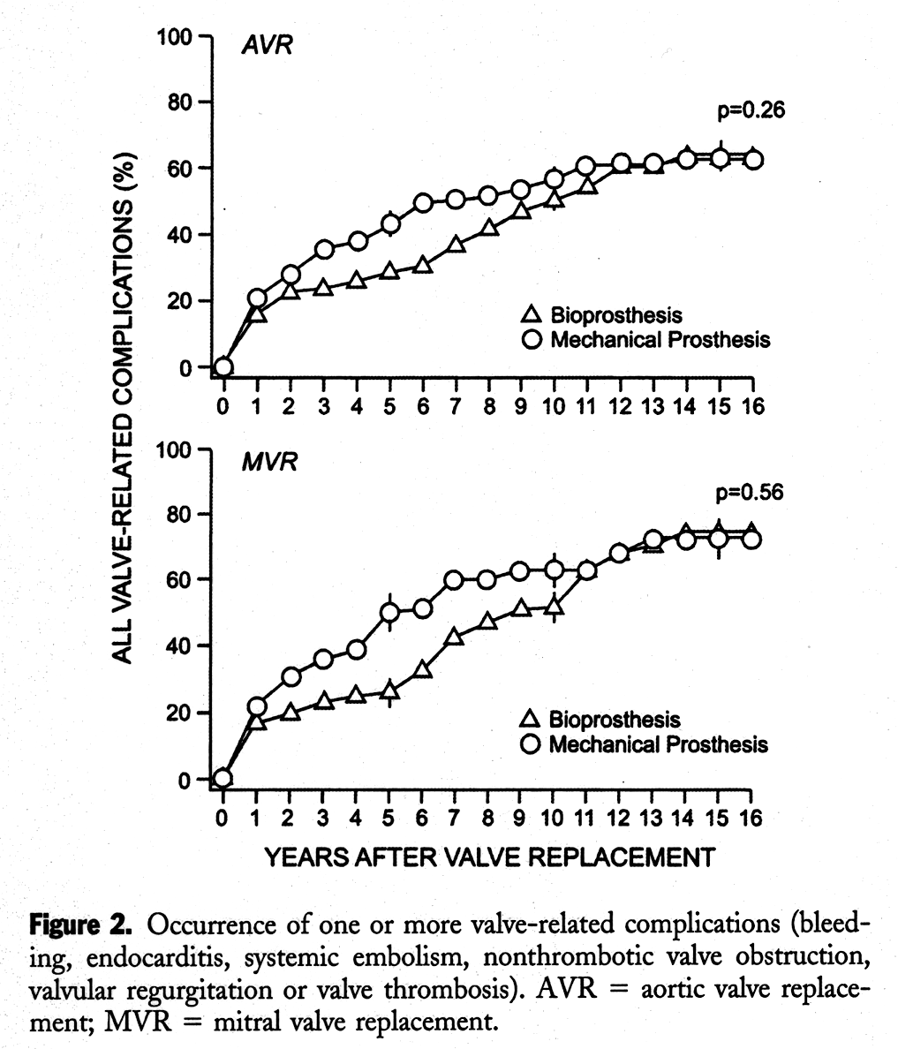
Aortic Valve Replacement
Thromboembolism
Anticoagulation/Hemorrhage
Structural failure
PV endocarditis
Incidence of valve-
related complications
Hammermeister et al, JACC 2000
Notes:
4

Slide 5
AVR - Mechanical
Prosthesis-related Complications
years after valve replacement
Ikonomidis JS, JTCVS 2003
THG
Notes:
5
.

Slide 6
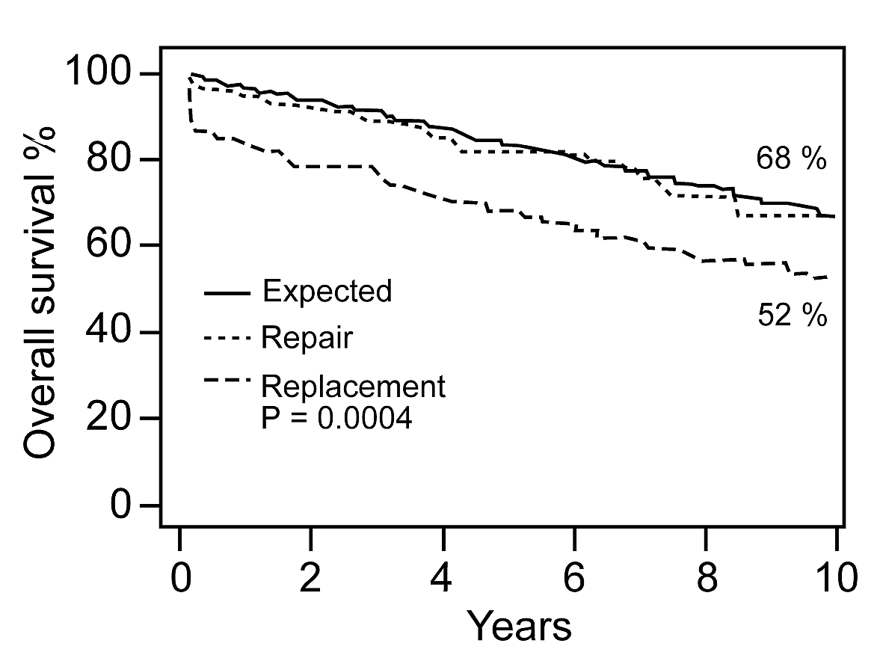
Repair vs. Replacement (Mitral)
Mohty D, Curr. Card. 2002

Slide 7
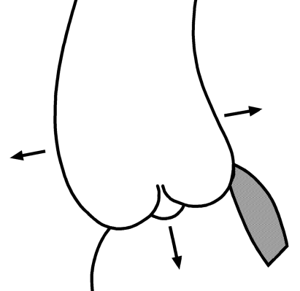
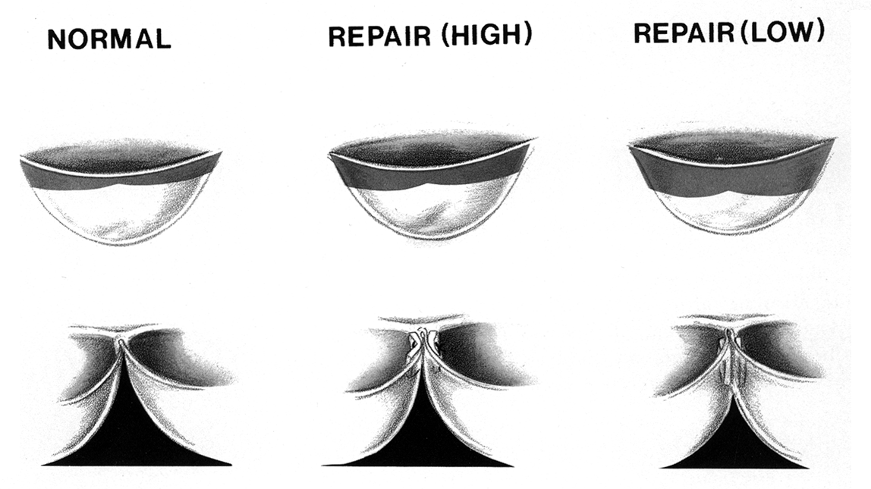
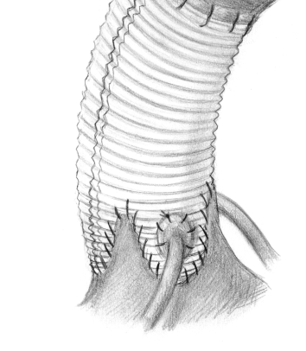
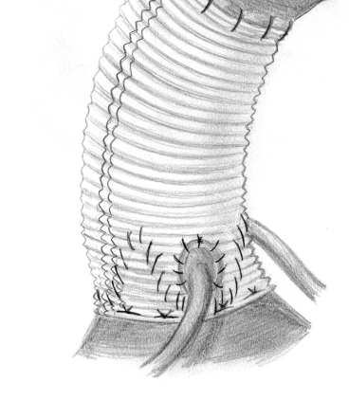
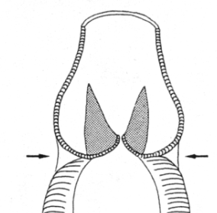
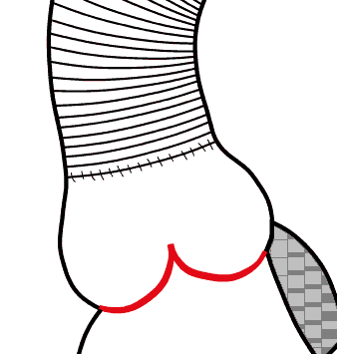
Root Repair – Technical Options
Subcommissural
Plication
Reimplantation
of Aortic Valve
ST Junction
Remodelling
Root Remodeling
(Cabrol 1966)
(STJ < 33mm
AVJ > 25mm)
(Frater 1986)
(Sinus < 45 mm,
STJ ≤ 32 (39) mm
(David 1992)
(AVJ ≥ 30 mm)
(Yacoub 1993)
(Sinus > 45 mm (TEE),
AVJ < 30 mm)
THG
Notes:
7

Slide 8
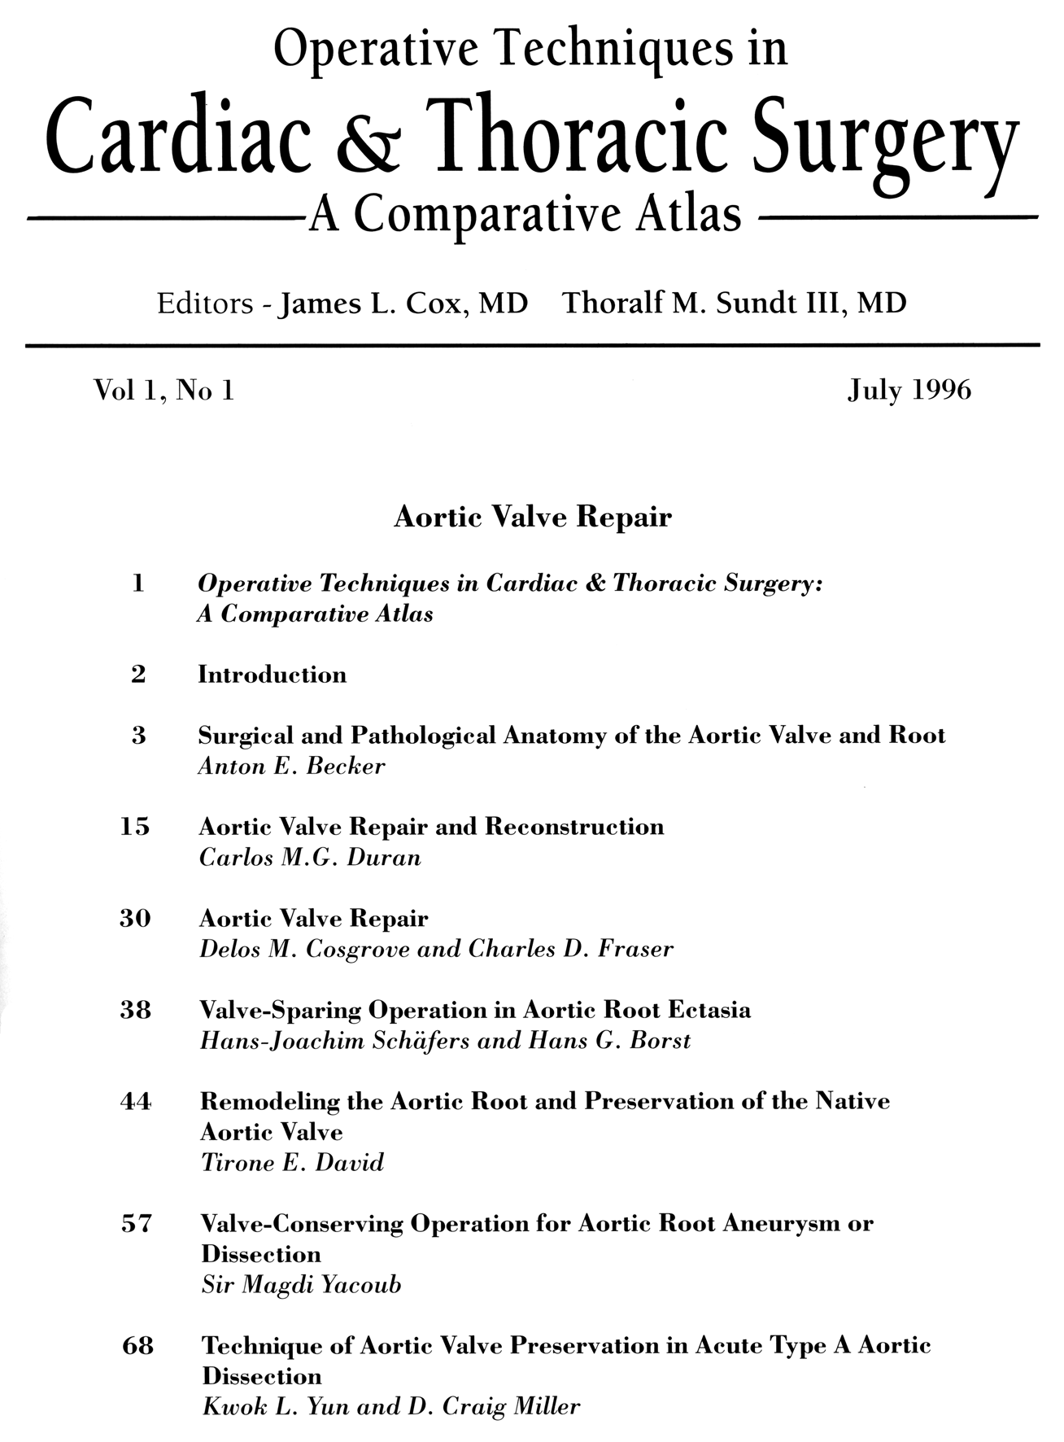
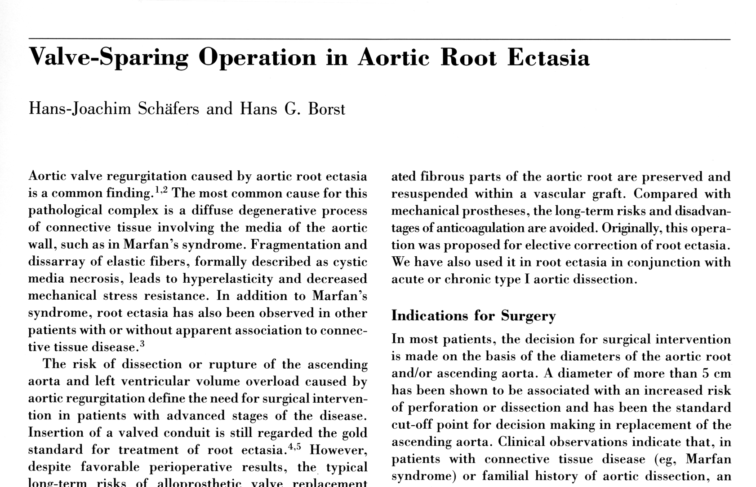
Aortic Valve Repair
THG
Notes:
8
.

Slide 9
Aortic Valve Repair
THG
Notes:
9
.

Slide 10
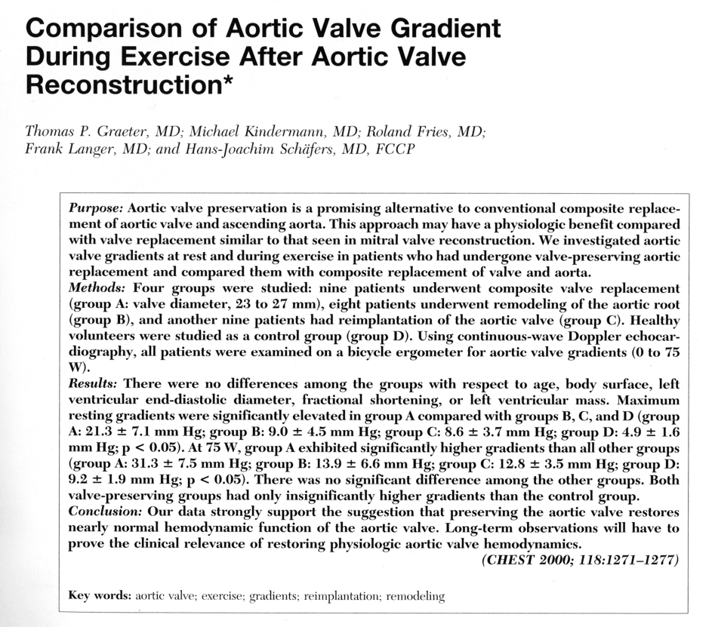
Aortic Valve Repair
THG
Notes:
10
.

Slide 11
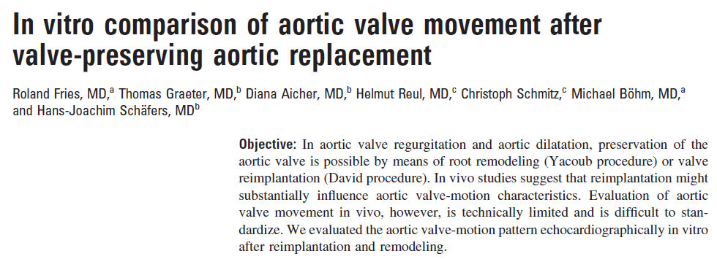
THG
Notes:
11

Slide 12
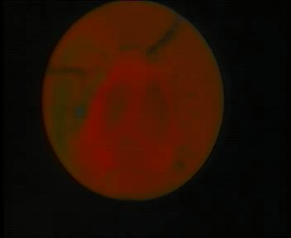
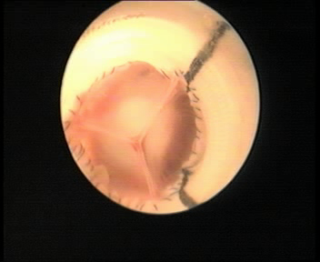
Reimplantation
Remodeling
2 l/min

Slide 13
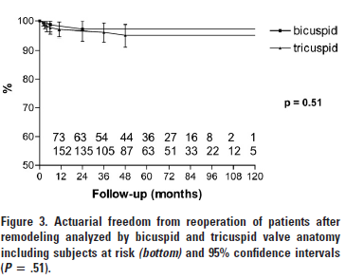
THG
Notes:
13

Slide 14
THG
Notes:
14

Slide 15
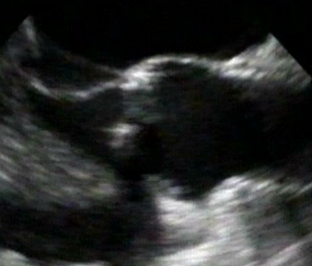
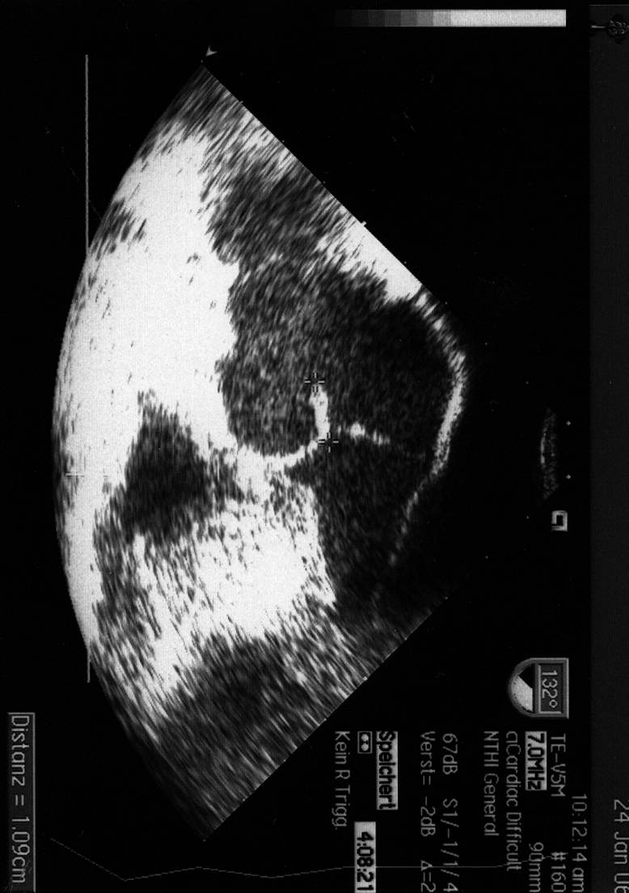
Reduction of STJ and Cusp Prolapse
b
a
b‘
a‘
C_{E} = π × [3/2×(a+b) - √a×b]
b ≈ r_{aorta}
a ≈ r_{cusp}
r_{cusp} ≈ 1 / r_{aorta}

Slide 16
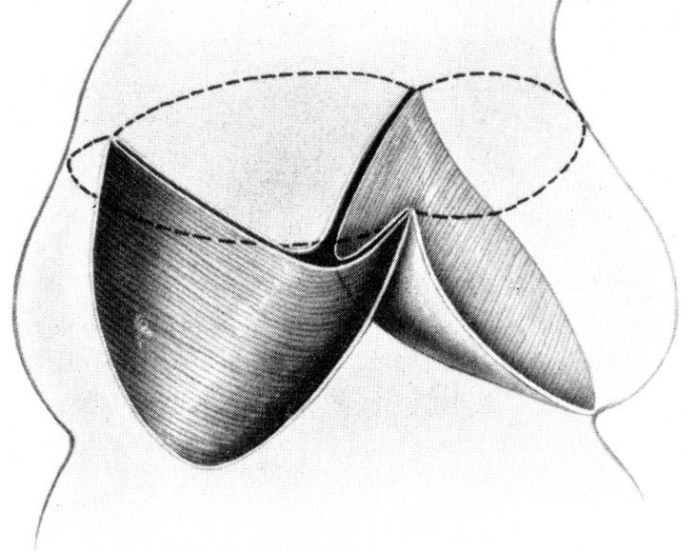
Aortic Valve Repair - Difficulties
Dimensions- of aortic root/(ring)
THG
Notes:
16

Slide 17
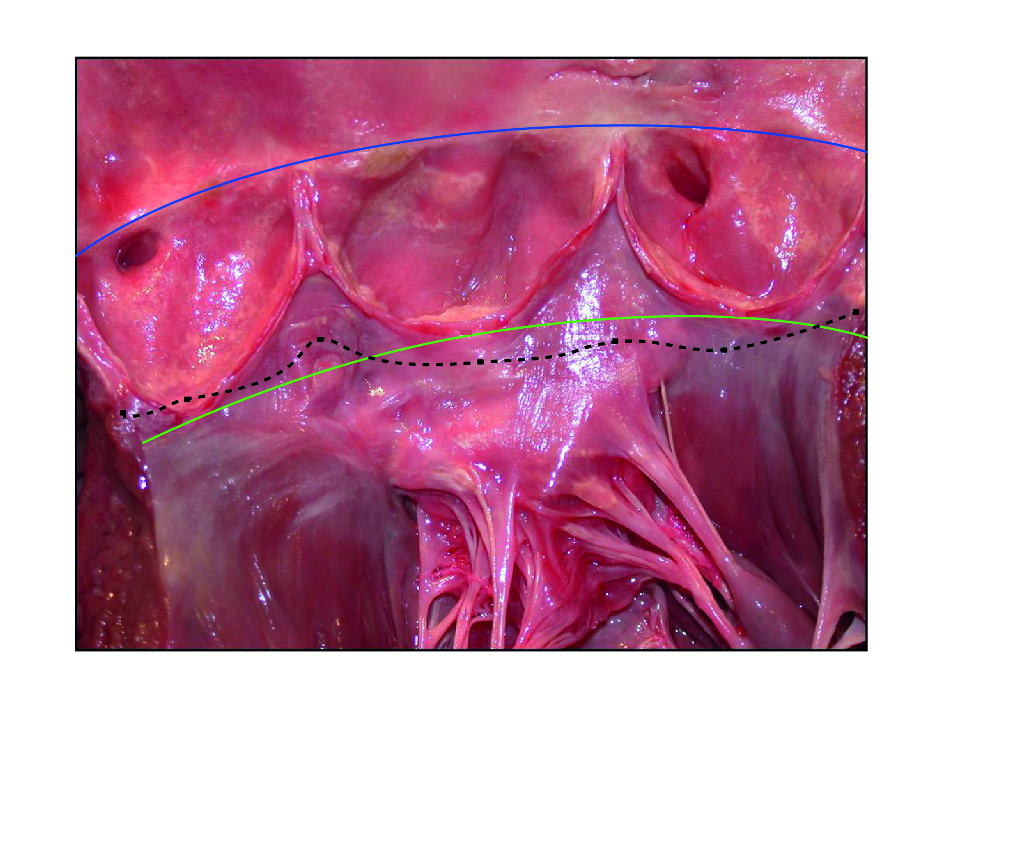
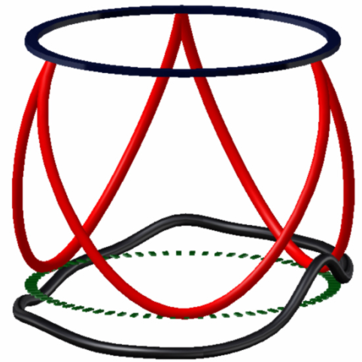
NC
L
R
Courtesy of E. Lansac
Notes:
17

Slide 18
Aortic Valve Repair - Difficulties
Configuration/coaptation of cusps
Vision from outflow
THG
Notes:
18

Slide 19
Aortic Valve Repair - Difficulties
Geometry altered by
non-pressurized state
THG
Notes:
19

Slide 20

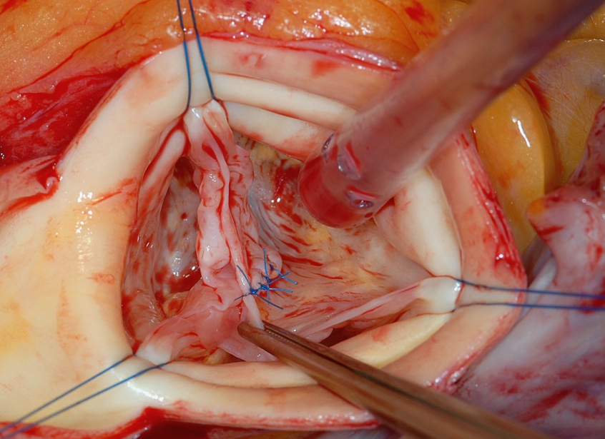
Solutions
Geometry altered by non-pressurized state!
Stay sutures!
THG
Notes:
20

Slide 21
Aortic Valve Repair - Assessment
Difficulties
Dimensions- of aortic root/(ring)
Configuration/coaptation of cusps
Vision from outflow
Geometry altered by non-filled state!
THG
Notes:
21

Slide 22
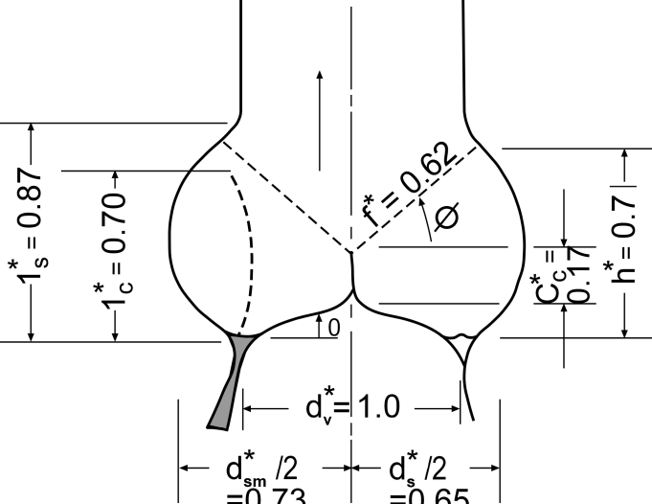
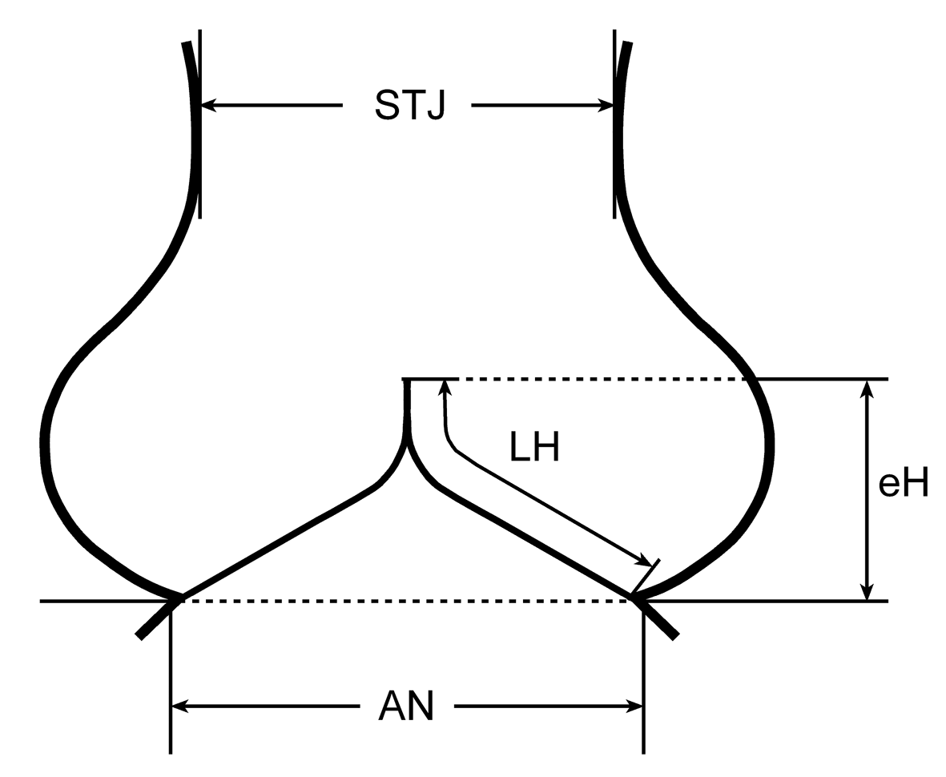

Aortic Valve Repair - Assessment
Solutions
Configuration/coaptation of cusps
?
Swanson, Circ Res 1974
THG
Notes:
22

Slide 23
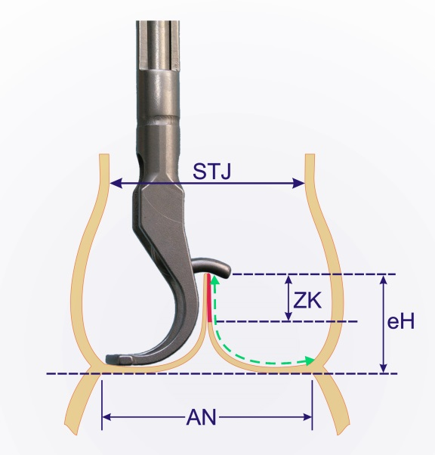
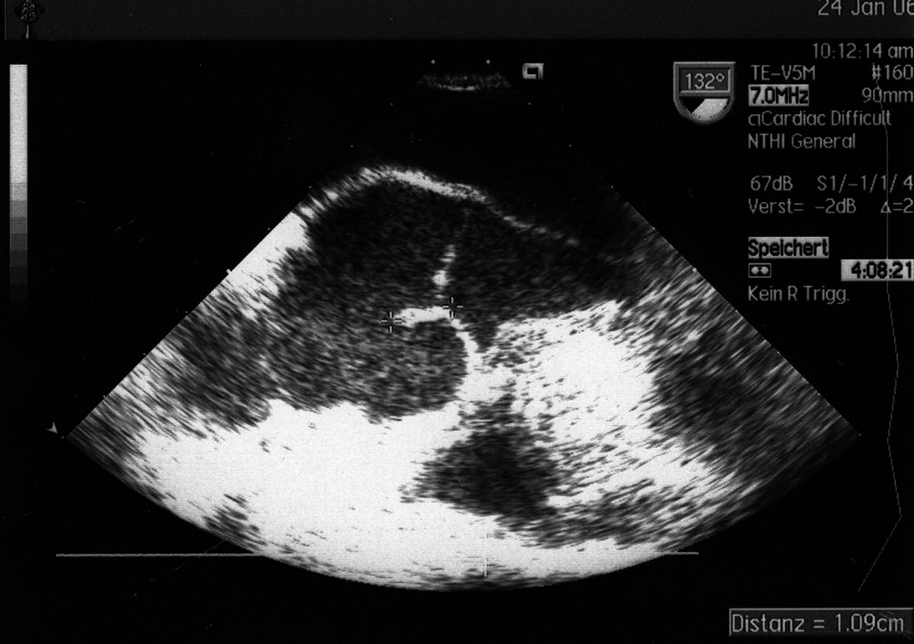
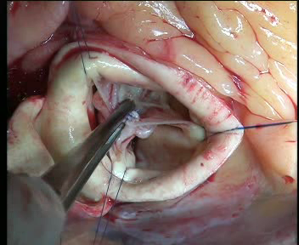
Cusp Configuration
effective height
1cm
Schäfers HJ et al, JTCVS 2006
THG
Notes:
23
..und diese Höhe seit 1/2005 sowohl intraoperativ mittels einer Schublehre als auch echokardiografisch zur Objektivierung eines Taschenprolapses gemessen.
Patienten mit einer effektiven Höhe von mehr 8 mm wiesen eine kompetente Klappe auf.

Slide 24
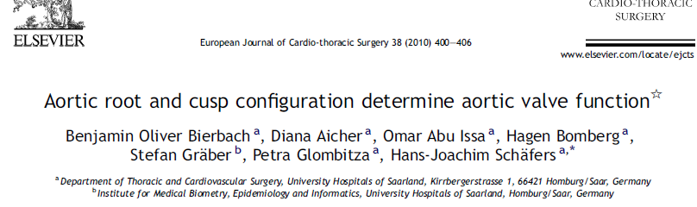
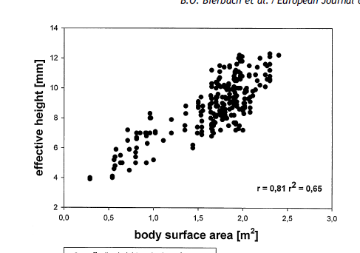
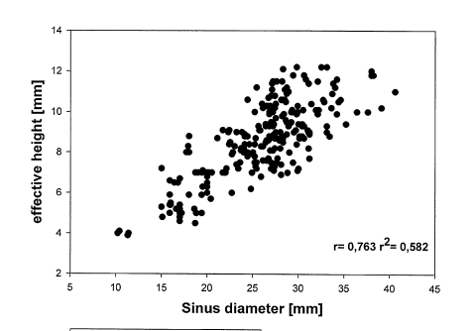
Effective Height
effective height
1cm
THG
Notes:
24

Slide 25
Anatomical Limitations of Aortic Valve Repair
Restrictive pathology
Notes:
25

Slide 26

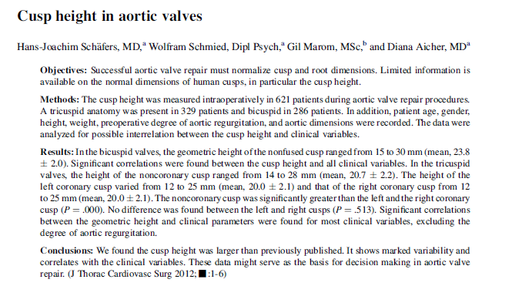
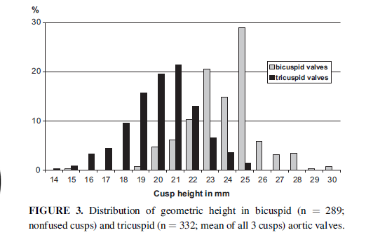
Aortic Valve Repair - Assessment
Solutions
Configuration/coaptation of cusps
THG
Notes:
26

Slide 27
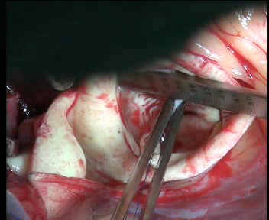
Aortic Valve Repair - Assessment
Configuration/coaptation of cusps
TAV: 17-22 mm
BAV: 20-25 mm
THG
Notes:
27

Slide 28
Causes of Cusp Pathology
Prolapse n=606/826 =73%
  (right > non > left-coronary cusp)
Congenital malformation
  bicuspid n=276
  unicuspid n =50
  quadricuspid n =3
Retraction / Calcium n=42
Congenital
Retraction
Prolapse
Notes:
28
.

Slide 29
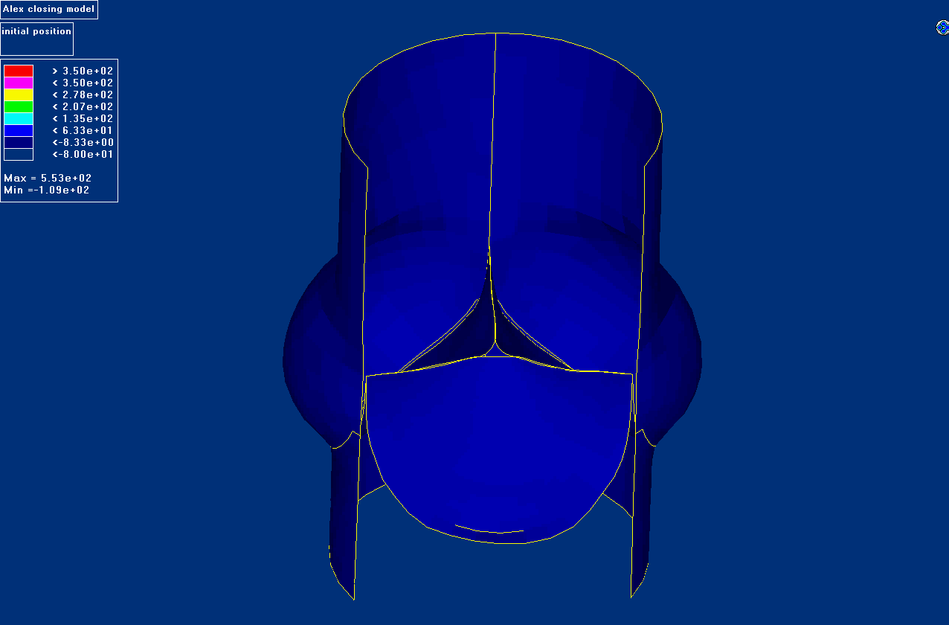
Aortic valve – stress distribution
Notes:
29

Slide 30
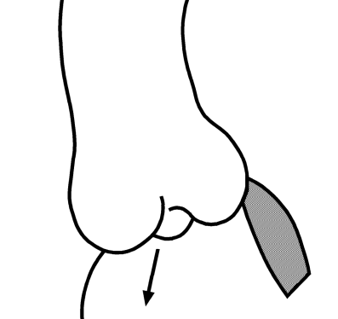
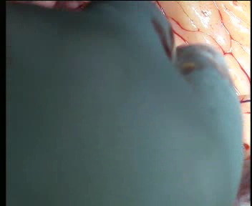
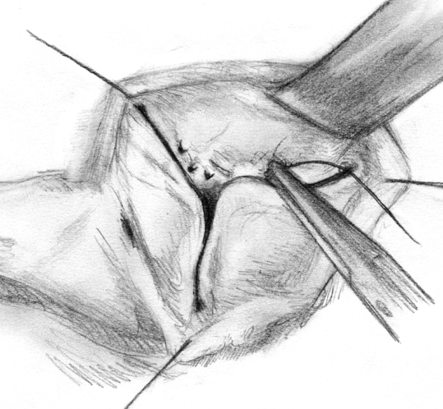
Reconstructive Techniques
Cusp Pathology
Prolapse
Plication of
Cusp Margin
Notes:
30

Slide 31
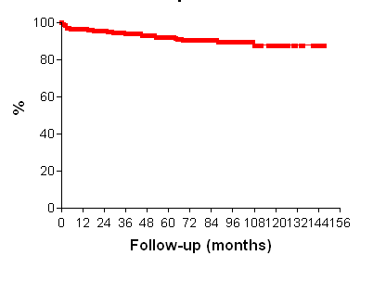
Aortic Valve Repair
Freedom from Valve-related Complications
86%
Incidence of valve-
related complications
Hammermeister et al, JACC 2000
Notes:
31

Slide 33
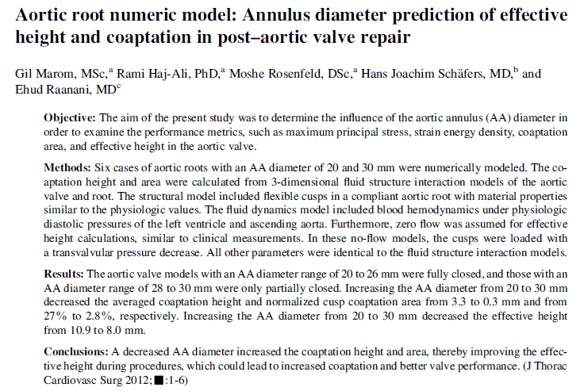

Slide 35
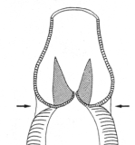
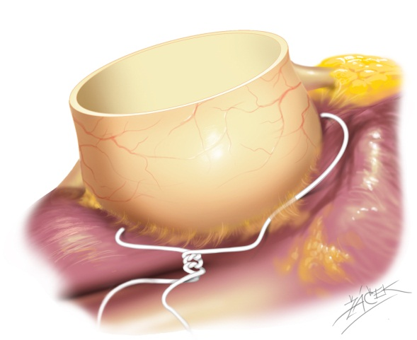


Root Repair – Technical Options
Subcommissural
Plication
Aortic Annuloplasty
(AVJ > 25-27mm)
?
(Cabrol 1966)
THG
Notes:
35

Slide 36
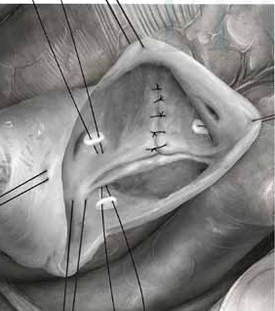
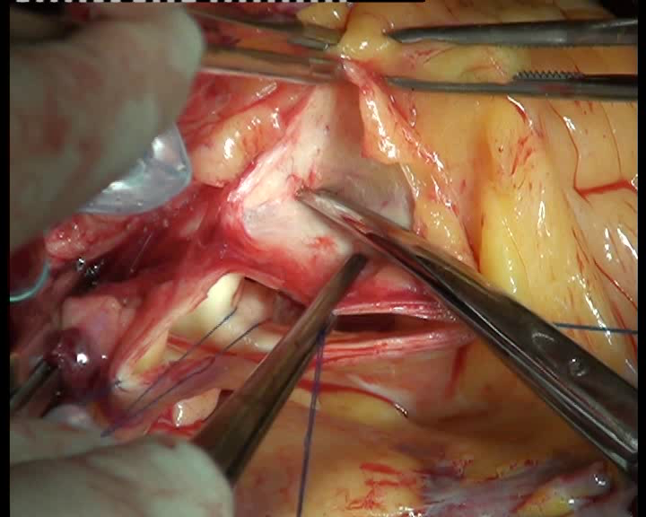
Correction of AV dilatation:

Slide 37
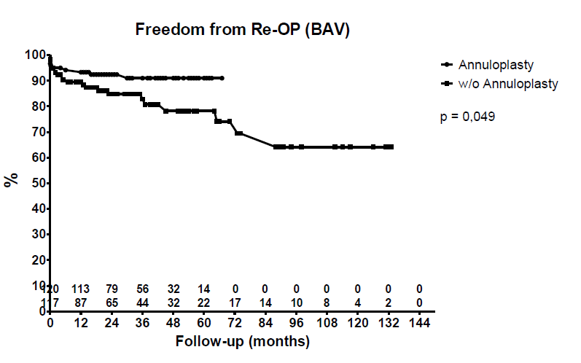
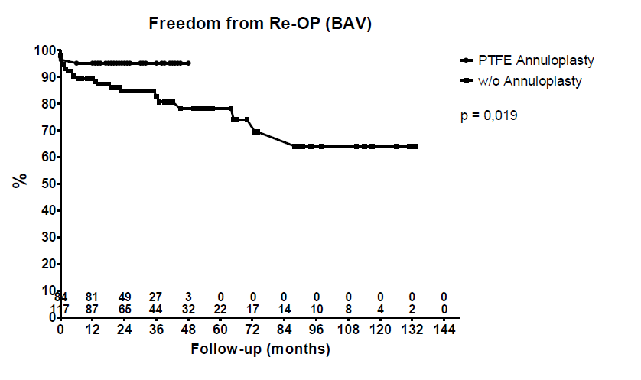

Slide 38
Freedom from Reoperation – all BAV
Predictors of Failure
p p
univar. multivar.
Patient age < 40 yrs. 0.0051 0.001
Orientation of comm. (<160°) 0.0001 0.002
Non-root replacement 0.0018
Cabrol suture 0.04
Pericardial patch 0.0001 0.0001
AV diameter (>28 mm) 0.0005 0.007
ST diameter (≤ 30 mm) 0.0142
Effective height < 9mm 0.0013 0.002
Preop AR > III 0.0029
THG
Notes:
Die Rekonstruktion der bikuspiden Aortenklappe ohne Dilatation der Aorta hat eine gute mittelfristige Stabilität.
Bei dilatierter Aorta erbringt die Kombination aus Klappen-rekonstruktion und Remodellieren ebenfalls gute Stabilität.
Die Kombination von suprakommissuralem Aortenersatz + separater Klappenrekonstruktion ist bei einigen Patienten möglicherweise eine weniger komplexe Alternative.
Vorsicht ist bei der Reduktion des ST Durchmesser geboten, weil dadurch immer ein symmetrischer Prolaps induziert wird, der die funktionelle Stabilität der Klappe beeinträchtigt.
Wir denken, dass dieser Prolaps korrigiert werden muss.
Die effektive Höhe ist in der Zukunft möglicherweise ein einfacher Parameter zur Objektivierung von Taschenprolaps.

Slide 39
Aortic Valve Reconstruction
AV reconstruction is on ist way to a rational and reproducible
approach (A + B + C + ? = functioning AV)
Scientific basis is becoming clearer
Valve-related complications are rare if repair is stable
AV reconstruction should be considered in every patient
with AR

Slide 40
Thank you for your attention
THG
Notes:
40
Dauer: 7 Minuten Vortrag; 3 Minuten Diskussion

