Slide 1
Aortic Valve Repair:
A Modular (Standardized) Approach
H.-J. Schäfers
Dept. of Thoracic and Cardiovascular Surgery
Saarland University Medical Center
Homburg/ Saar, Germany

Slide 2
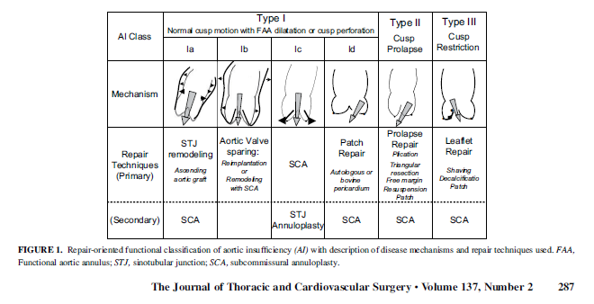


Limitations:
Purely echocardiographic, does not directly
relate to morphology/pathology
Does not provide morphologic cut-offs for
decision making
Insensitive in defining cusp prolapse in presence
of marked aortic dilatation
Type III does not differentiate between
restricion due to aortic dilatation and
restriction due to cusp degeneration/retraction
THG
Notes:
2

Slide 3
THG
Notes:
3

Slide 4
Causes of Aortic Regurgitation
Root pathology
Aortic aneurysm
Aortic dissection
Congenital abnormalities
Myxomatous degeneration
Rheumatic disease
Infective endocarditis
Calcific degeneration
Cusp pathology
THG

Slide 5
THG
Notes:
..und diese Höhe seit 1/2005 sowohl intraoperativ mittels einer Schublehre als auch echokardiografisch zur Objektivierung eines Taschenprolapses gemessen.
Patienten mit einer effektiven Höhe von mehr 8 mm wiesen eine kompetente Klappe auf.

Slide 6
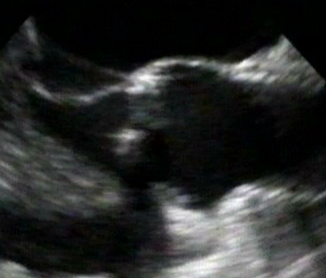
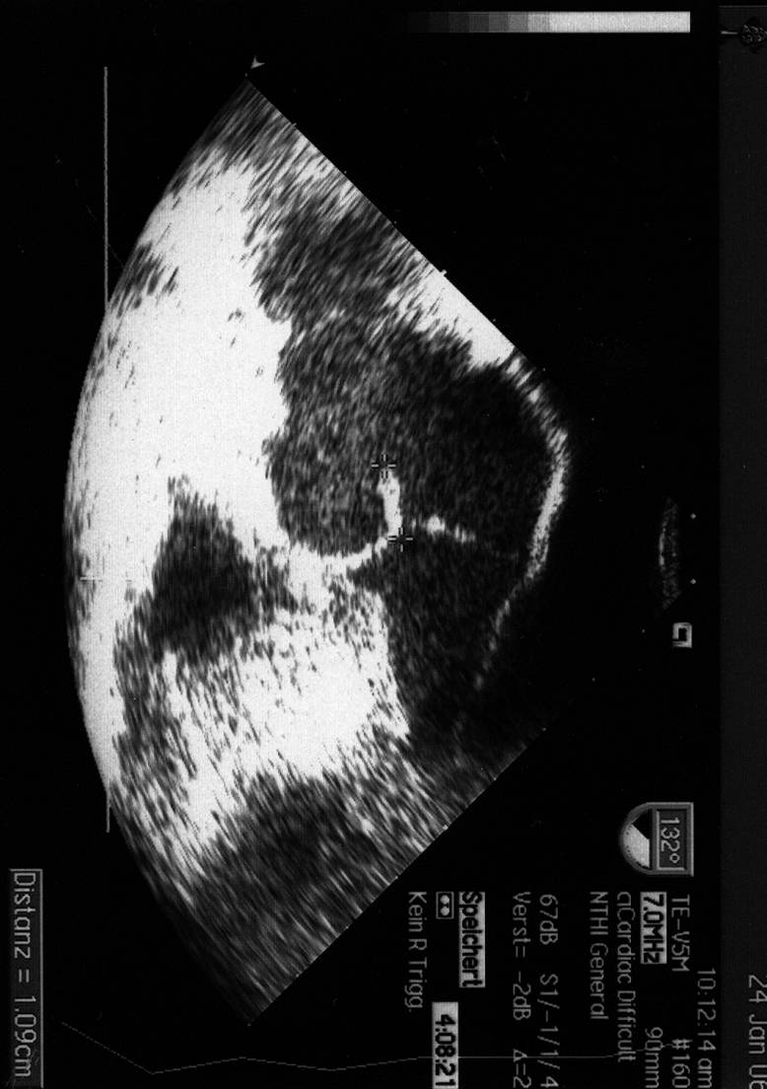
Reduction of STJ and Cusp Prolapse
b
a
b‘
a‘
C_{E} = π × [3/2×(a+b) - √a×b]
b ≈ r_{aorta}
a ≈ r_{cusp}
r_{cusp} ≈ 1 / r_{aorta}

Slide 7
Standardized Aortic Valve Repair
Root pathology
Assessment
Correction
Valve morphology
Cusp pathology
THG
Notes:
7

Slide 8
Standardized Aortic Valve Repair
Assessment root
Assessment cusps
Correction root
Correction cusps
THG
Notes:
8

Slide 9
Root Assessment
Echo:
Maximum sinus diameter ► >40 / 45 mm?
ST diameter ► >35 (?)
Annular diameter (?)
Intraoperative:
Annular diameter (!) ► >25 / 28 mm?
THG
Notes:
9

Slide 10
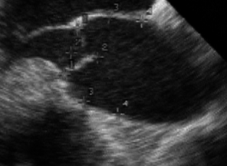
AI und TTE/TEE
Root dimensions
AV morphology (bi-/tricuspid)
Prolapse
Calcification?

Slide 11
Cusp Assessment
Echo:
Valve morphology?
Eccentricity of jet?
Intraoperative:
Valve Morphology?
Cusp height/configuration?
Cusp substance?
THG
Notes:
11

Slide 12
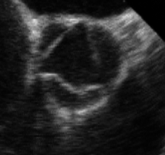
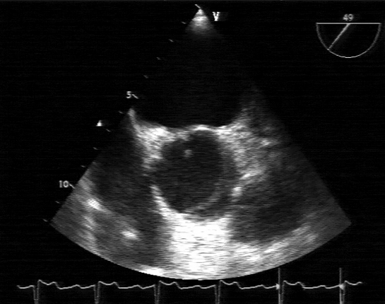
AI und TTE/TEE
Root dimensions
AV morphology (bi-/tricuspid)
Prolapse
Calcification?

Slide 13
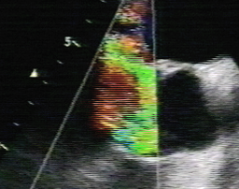
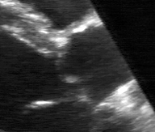
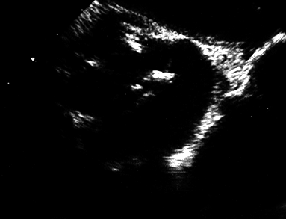
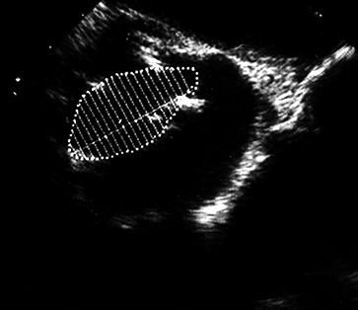
AI und TTE/TEE
Root dimensions
AV morphology (bi-/tricuspid)
Prolapse
Calcification?

Slide 14
Cusp Assessment
Morphology (commissural height):
Unicuspid
Bicuspid
Tricuspid
Quadricuspid
If non-tricuspid, watch for anatomical variation
Prolapse?
Retraction?
THG
Notes:
14

Slide 15
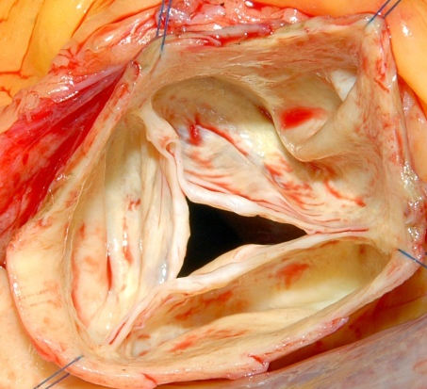
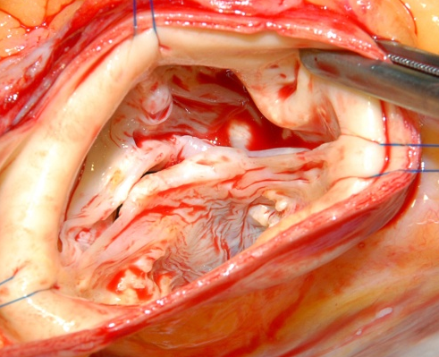
Bicuspid Aortic Valve (BAV)
Morphology
pattern of fusion
degree of fusion
180°
179-121°
120°
commissural
orientation
Sabet et al, Mayo Clin Proc, 1999;74:14-26
THG
Notes:
15

Slide 16
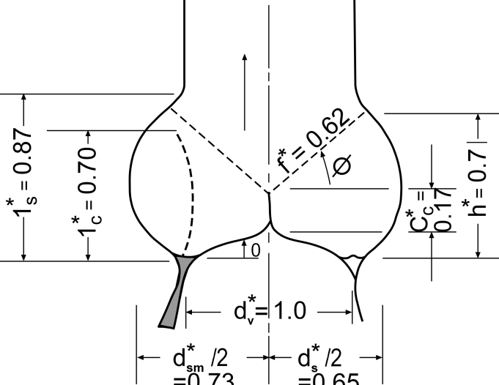
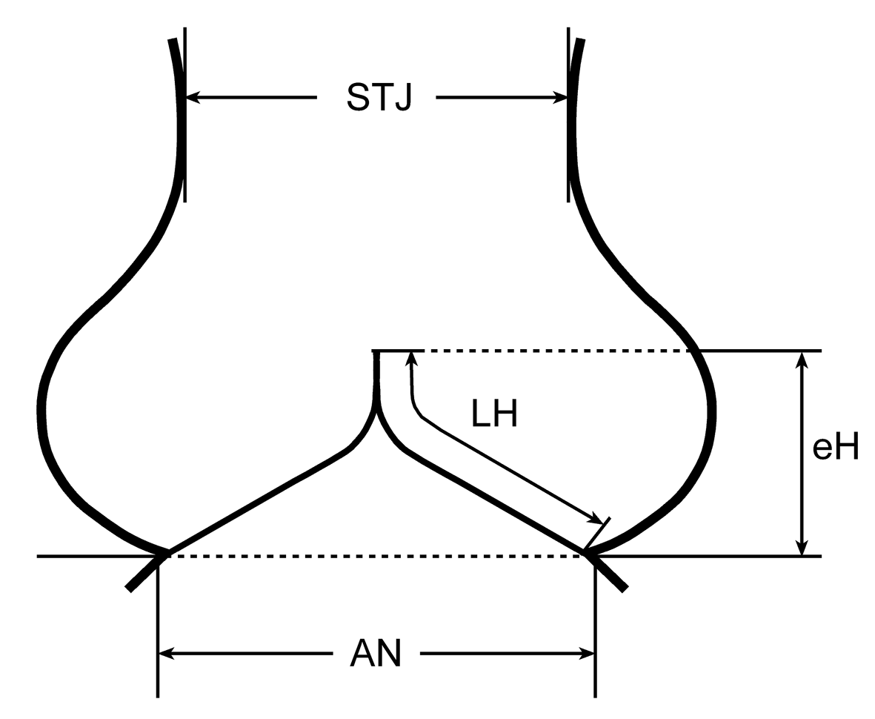

Aortic Valve Repair - Assessment
Configuration of cusps
?
Swanson, Circ Res 1974
THG
Notes:
16

Slide 17
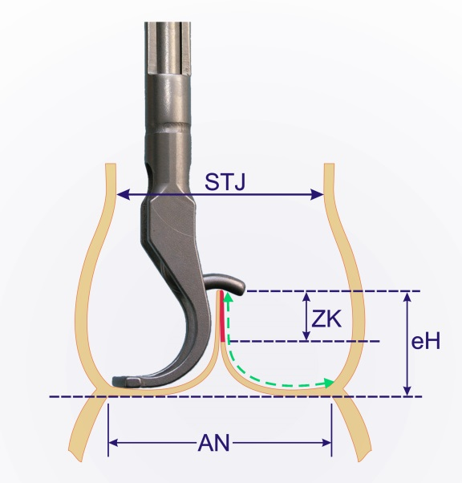
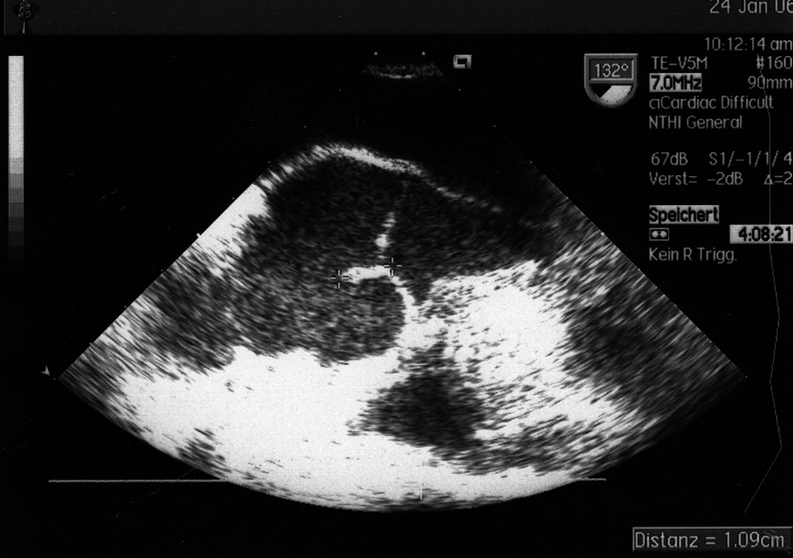
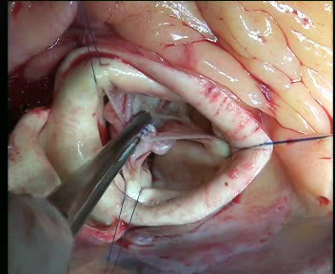
Cusp Configuration
effective height
1cm
Schäfers HJ et al, JTCVS 2006
THG
Notes:
17
..und diese Höhe seit 1/2005 sowohl intraoperativ mittels einer Schublehre als auch echokardiografisch zur Objektivierung eines Taschenprolapses gemessen.
Patienten mit einer effektiven Höhe von mehr 8 mm wiesen eine kompetente Klappe auf.

Slide 18
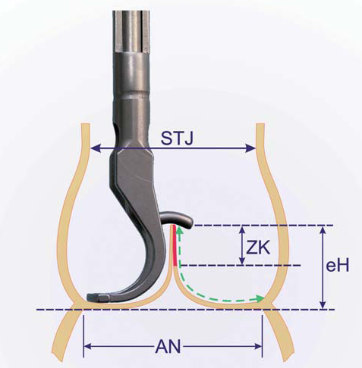
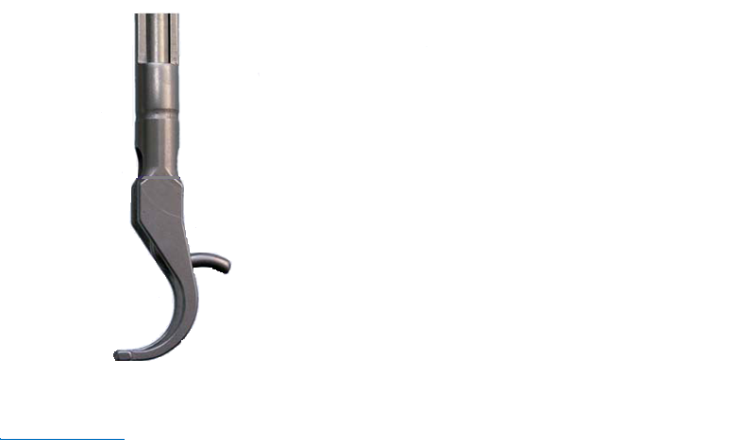
eH Measurement Error
Notes:
If it is not you can easily underestimate or overestimate Eh

Slide 19
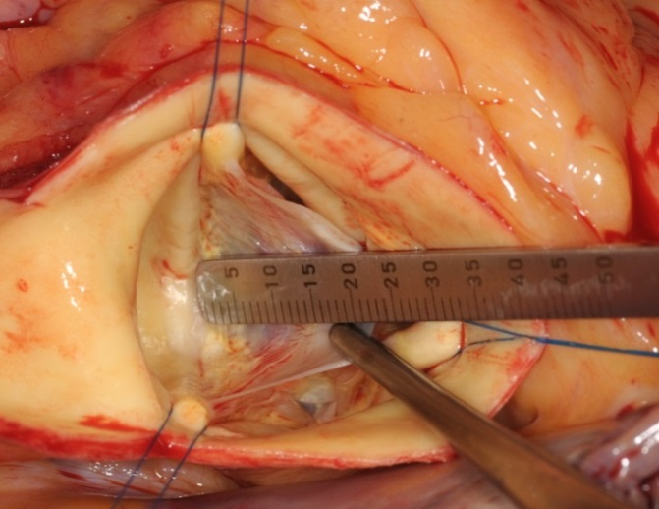
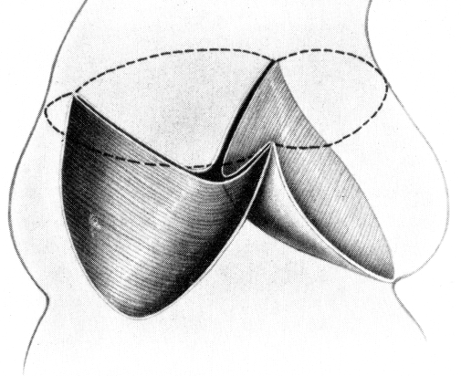
Configurationof cusps
THG
Notes:
19

Slide 20
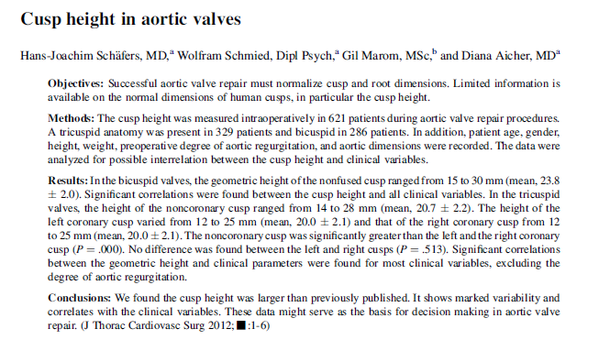
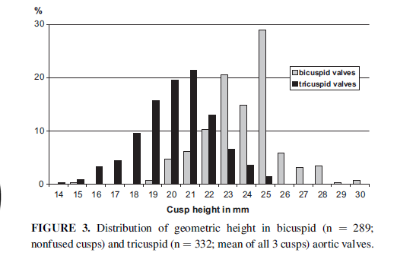
Aortic Valve Repair - Assessment
Solutions
Configuration/coaptation of cusps
THG
Notes:
20

Slide 21
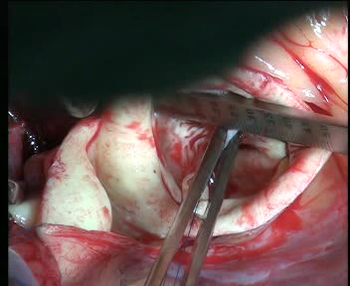
Aortic Valve Repair - Assessment
Configuration/coaptation of cusps
TAV: 17-22 mm
BAV: 20-25 mm
THG
Notes:
21

Slide 22
Root Correction
If
Sinus > 40 -45 mm
Root remodeling
(Valve reimplantation)
Sinus < 40-45
STJ remodeling
THG
Notes:
22

Slide 23
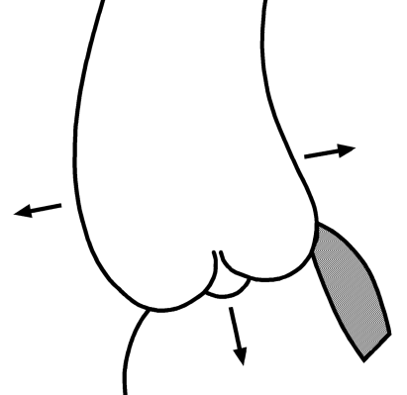
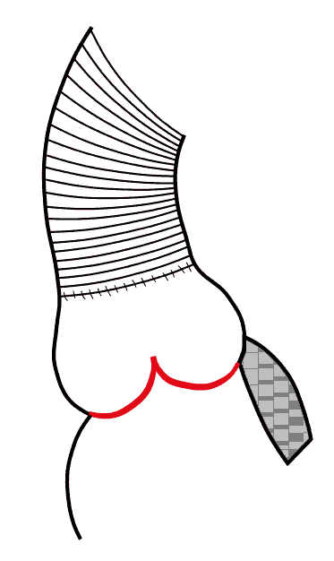
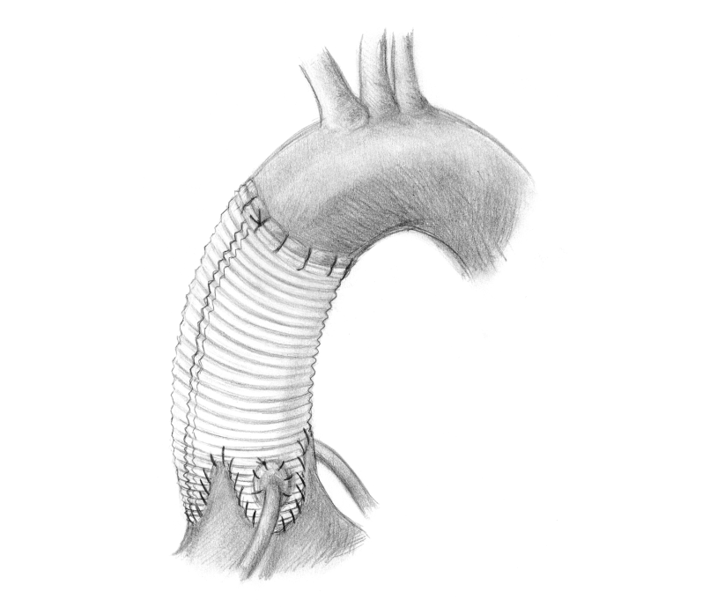
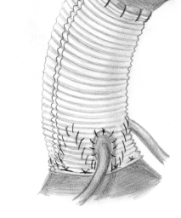
Root Repair – Technical Options
ST Junction
Remodelling
Root Remodeling
Reimplantation
of Aortic Valve
(David 1992)
(AVJ ≥ 30 mm)
(Frater 1986)
(Sinus < 40-45 mm)
(Yacoub 1993)
(Sinus > 45 mm),
THG
Notes:
23

Slide 24

Valve Sparing:
Our Routine
Measure gH and
proceed with VPS if
gH ≥ 18 mm
2. (Root remodeling) Take graft according to patient size
BSA < 1.8 m² 24 mm
1.8 to 2.2 m² 26 mm
>2.2 m² 28 mm (?)
if gH ≤ 20 mm consider graft 1 size less
THG
Notes:
24
..und diese Höhe seit 1/2005 sowohl intraoperativ mittels einer Schublehre als auch echokardiografisch zur Objektivierung eines Taschenprolapses gemessen.
Patienten mit einer effektiven Höhe von mehr 8 mm wiesen eine kompetente Klappe auf.

Slide 25
AORTIC VALVE REPAIR
n=1832
Reimplantation
Remodeling
AV repair
STJ remodeling ± AVR
THG
04/10
Notes:
25

Slide 26
Cusp Correction
If
prolapse (eH ≤ 8 mm)
structural defect
anatomical variant
Plication of free margin / triangular resection
Patch correction
Conversion of anatomy (BAV, TAV constant)
UAV ► BAV
QAV ► TAV
THG
Notes:
26

Slide 27
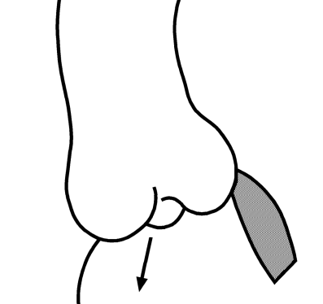
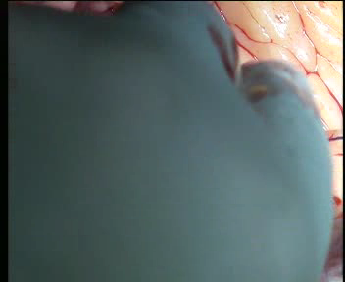
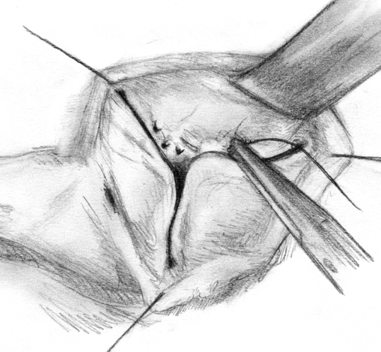
Reconstructive Techniques
Cusp Pathology
Prolapse
Plication of
Cusp Margin
Notes:
27

Slide 28
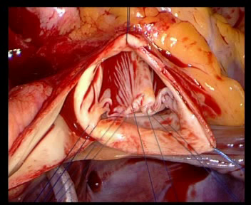
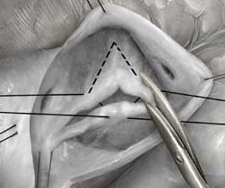
Reconstructive Techniques
Cusp Pathology
Fibrosis,
Calcium,
Redundancy
Triangular
Resection
THG
Notes:
28

Slide 29

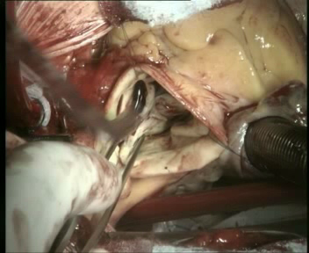
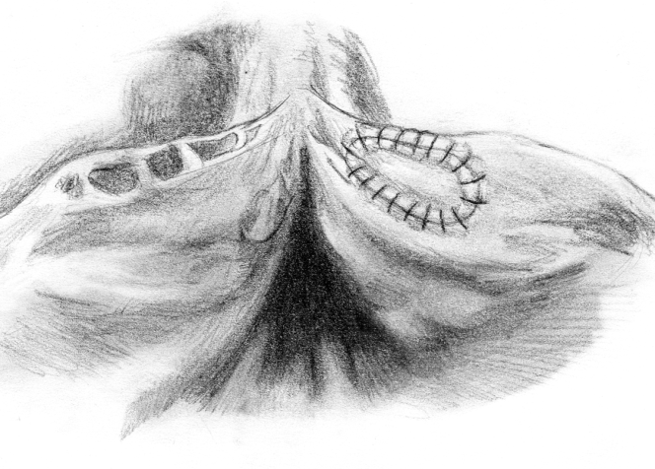
Reconstructive Techniques
Cusp Pathology
Fenestration
Stabilisation of
cusp (pericardium)

Slide 30
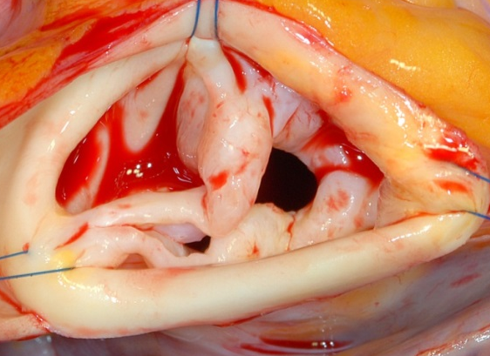
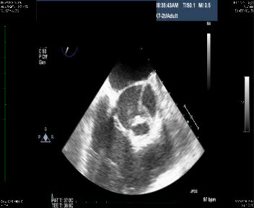
Bicuspidization of the Unicuspid Aortic Valve
unicuspid
bicuspid
THG
Anderson RA, JHVD 2001
Notes:
30

Slide 31
Aortic Valve Anatomy
Morphology Incidence Mean Age of Failure
Unicuspid < 1% 20s
Bicuspid 2% 60s
Tricuspid 97 %(?) ?
Quadricuspid < 1 % 40s
Roberts WC, Circulation
THG
Notes:
31

Slide 32

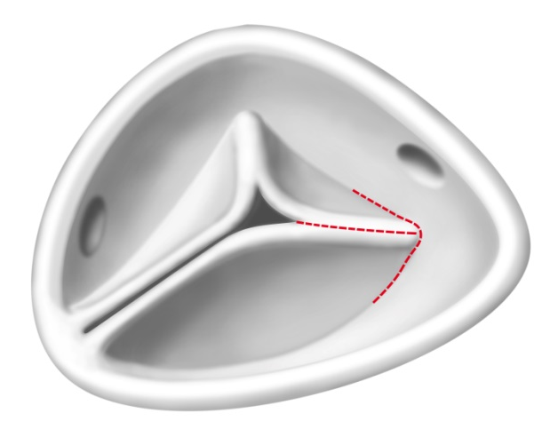
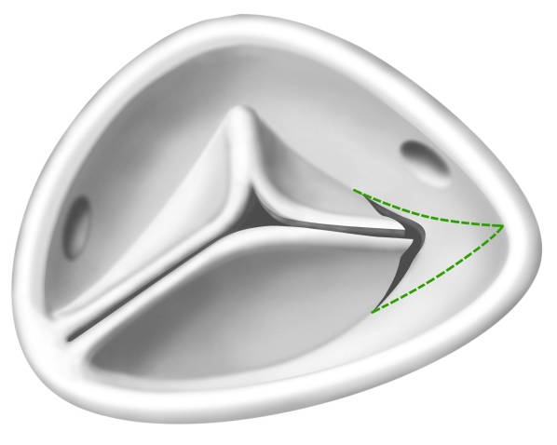
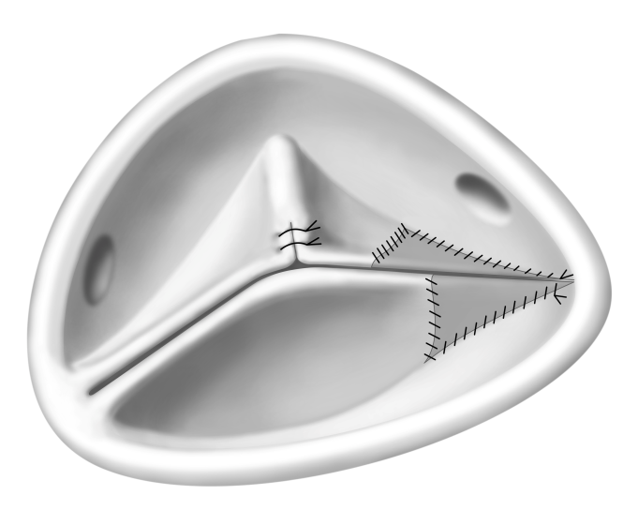
Bicuspidization of the
Unicuspid Aortic Valve
Schäfers HJ, ATS 2008
THG
Notes:
32

Slide 33

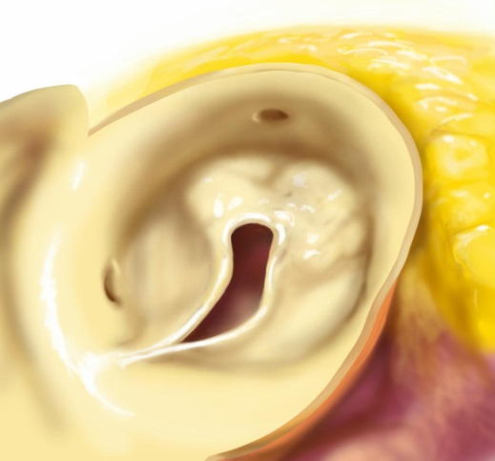
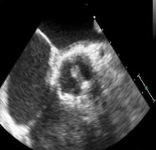
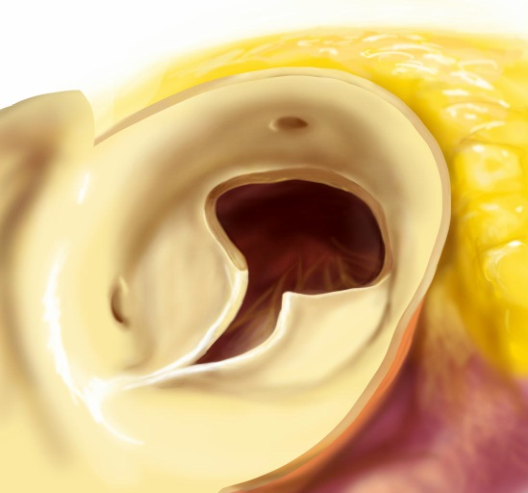
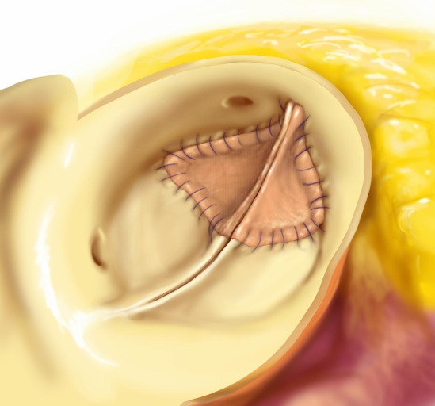
Bicuspidization of the
Unicuspid Aortic Valve II
THG
Notes:
33

Slide 34
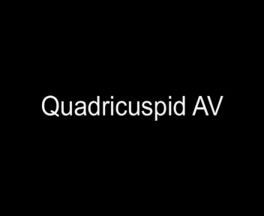
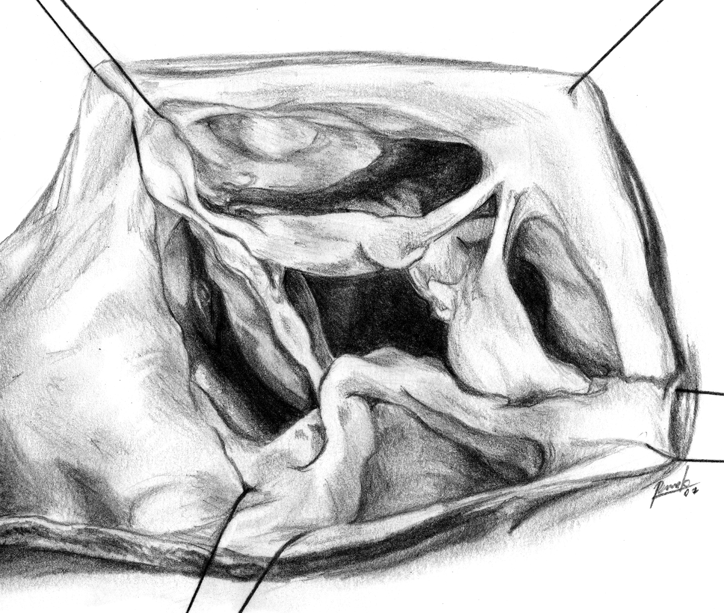
Reconstructive Techniques
Cusp Pathology
Anomaly
Conversion of
configuration
Schmidt et al., Ann Thorac Surg 2007
Notes:
34

Slide 35
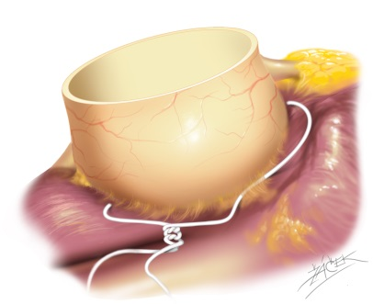
Annuloplasty
If
Basal diameter > 26-27 mm
Annular reduction
► 25 mm for BSA > 2 m²
► 23 mm for BSA < 2 m²
Reduce by 2 mm for
gH < 19 (TAV) / 22 (BAV) mm
THG
Notes:
35

Slide 36
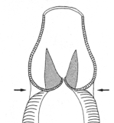
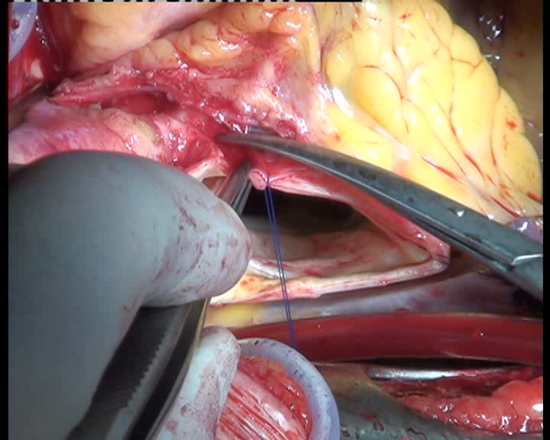

Repair – Technical Options
Aortoventricular Stabilisation
(AVJ > 27mm)
Subcommissural
Plication
?
(Cabrol 1966)
THG
Notes:
36

Slide 37
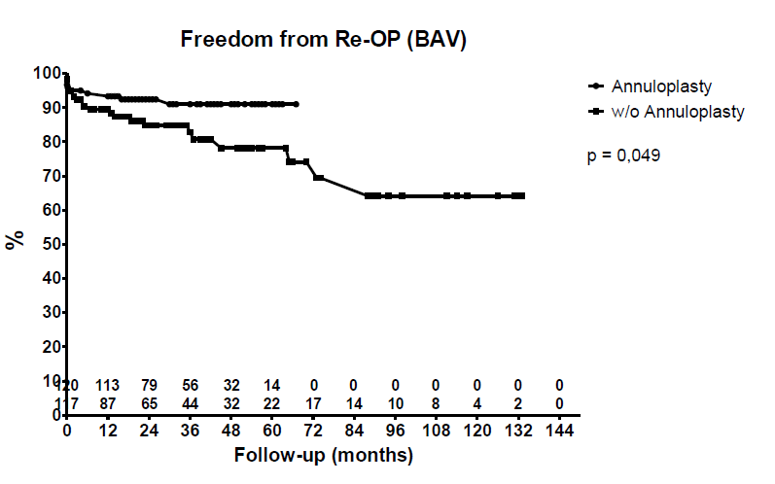


Slide 38
Standardized Aortic Valve Repair
No relevant calcification,
geometric cusp height > 17-20 mm
Decision for valve preservation
2. Sinus diameter > 40 -45 mm
(and /or BAV < 150° ?)
Root replacement
THG
Notes:
38

Slide 39
Reduction of STJ and Cusp Prolapse
b
a
b‘
a‘
C_{E} = π × [3/2×(a+b) - √a×b]
b ≈ r_{aorta}
a ≈ r_{cusp}
r_{cusp} ≈ 1 / r_{aorta}

Slide 40
Standardized Aortic Valve Repair
3. If root + cusp necessary,
Root repair first (interaction between
intercommissural distance and cusp
configuration)
4. Annular stabilization (AI, durability)
5. Correction of cusp prolapse (eH)
THG
Notes:
40

Slide 41
Conclusions
Systematic analysis + correction of pathologic components
Many strategies defined
Normalize cusp configuration (effective height)!
Specific valve configurations require tailored approach
Notes:
41

Slide 42


Aortic Valve Reconstruction

Slide 43

Thank you for your attention
THG
Notes:
43
Dauer: 7 Minuten Vortrag; 3 Minuten Diskussion

Slide 44
Aortic Valve Repair
-
Standardized Approach
H.-J. Schäfers
Dept. of Thoracic and Cardiovascular Surgery
University Hospital of Saarland
Homburg/ Saar
Germany
THG
Notes:
44

